Slide 1
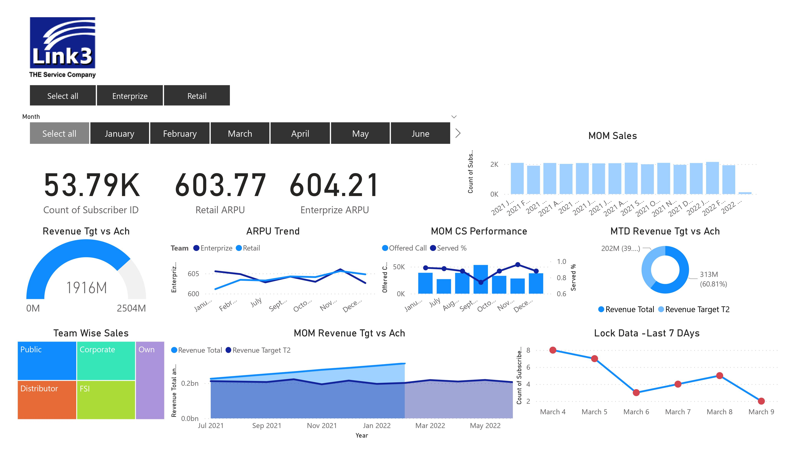
Implementing Dashboard in an Organization

Slide 2
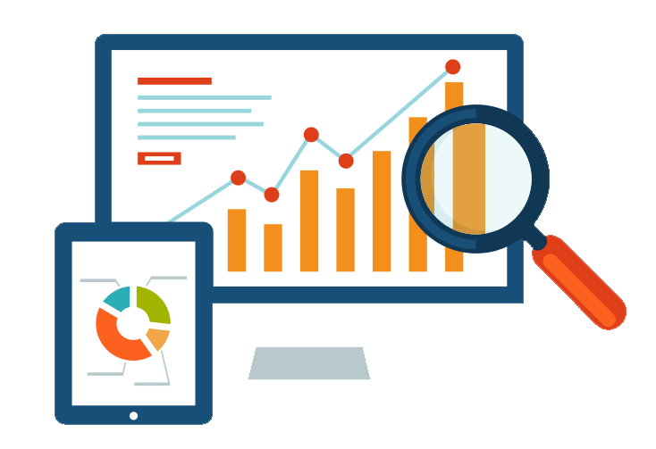
Benefits of a Real-time Dashboard

Slide 3
Provide a overall visibility of the business
A great resource saver
Improve reporting accuracy and transparency
Reduces dependencies
Provide the scope of faster and effective decision making
Have a very positive impact on the business performance

Slide 4

Challenges of Implementing Real-time Dashboard

Slide 5
Technical Challenges/Hard Issues
Various new API’s needs to be developed to link the data to the visualization software
Some data needs to be structured and correlated in order to provide a more clear picture in the dashboard
Additional computational capacity is required to run a real-time dashboard.

Slide 6

How Should We Go Forward

Slide 7
Take Inputs across the teams to understand their requirements and educated them into the dashboard systems business impacts.
Design the dashboards into Layer by layer (Phase by Phase)
Show it across the teams, explaining them the visualization and take their feedback.
Explain the dashboard to the IT team and provide the details of each visual elements data back ground.
Collect a Committed Delivery Dead Line from the IT team for phase by phase delivery.
After each phases delivery the visualized data needs to validate and tuned if necessary.
Published the dashboard and have UAT and QA seasons with the dashboard audience.

Slide 8
Take Inputs across the teams to understand their requirements and educated them into the dashboard systems business impacts.
Design the dashboards into Layer by layer (Phase by Phase)
Show it across the teams, explaining them the visualization and take their feedback.
Explain the dashboard to the IT team and provide the details of each visual elements data back ground.
Collect a Committed Delivery Dead Line from the IT team for phase by phase delivery.
After each phases delivery the visualized data needs to validate and tuned if necessary.
Published the dashboard and have UAT and QA seasons with the dashboard audience.

Slide 9
Take Inputs across the teams to understand their requirements and educated them into the dashboard systems business impacts.
Design the dashboards into Layer by layer (Phase by Phase)
Show it across the teams, explaining them the visualization and take their feedback.
Explain the dashboard to the IT team and provide the details of each visual elements data back ground.
Collect a Committed Delivery Dead Line from the IT team for phase by phase delivery.
After each phases delivery the visualized data needs to validate and tuned if necessary.
Published the dashboard and have UAT and QA seasons with the dashboard audience.

Slide 10
Take Inputs across the teams to understand their requirements and educated them into the dashboard systems business impacts.
Design the dashboards into Layer by layer (Phase by Phase)
Show it across the teams, explaining them the visualization and take their feedback.
Explain the dashboard to the IT team and provide the details of each visual elements data back ground.
Collect a Committed Delivery Dead Line from the IT team for phase by phase delivery.
After each phases delivery the visualized data needs to validate and tuned if necessary.
Published the dashboard and have UAT and QA seasons with the dashboard audience.

Slide 11
Take Inputs across the teams to understand their requirements and educated them into the dashboard systems business impacts.
Design the dashboards into Layer by layer (Phase by Phase)
Show it across the teams, explaining them the visualization and take their feedback.
Explain the dashboard to the IT team and provide the details of each visual elements data back ground.
Collect a Committed Delivery Dead Line from the IT team for phase by phase delivery.
After each phases delivery the visualized data needs to validate and tuned if necessary.
Published the dashboard and have UAT and QA seasons with the dashboard audience.

Slide 12
Take Inputs across the teams to understand their requirements and educated them into the dashboard systems business impacts.
Design the dashboards into Layer by layer (Phase by Phase)
Show it across the teams, explaining them the visualization and take their feedback.
Explain the dashboard to the IT team and provide the details of each visual elements data back ground.
Collect a Committed Delivery Dead Line from the IT team for phase by phase delivery.
After each phases delivery the visualized data needs to validate and tuned if necessary.
Published the dashboard and have UAT and QA seasons with the dashboard audience.

Slide 13
Take Inputs across the teams to understand their requirements and educated them into the dashboard systems business impacts.
Design the dashboards into Layer by layer (Phase by Phase)
Show it across the teams, explaining them the visualization and take their feedback.
Explain the dashboard to the IT team and provide the details of each visual elements data back ground.
Collect a Committed Delivery Dead Line from the IT team for phase by phase delivery.
After each phases delivery the visualized data needs to validate and tuned if necessary.
Published the dashboard and have UAT and QA seasons with the dashboard audience.

Slide 14
Take Inputs across the teams to understand their requirements and educated them into the dashboard systems business impacts.
Design the dashboards into Layer by layer (Phase by Phase)
Show it across the teams, explaining them the visualization and take their feedback.
Explain the dashboard to the IT team and provide the details of each visual elements data back ground.
Collect a Committed Delivery Dead Line from the IT team for phase by phase delivery.
After each phases delivery the visualized data needs to validate and tuned if necessary.
Published the dashboard and have UAT and QA seasons with the dashboard audience.

Slide 15
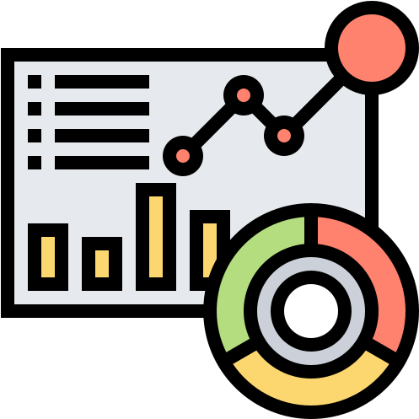
Commercial Dashboard Design

Slide 17
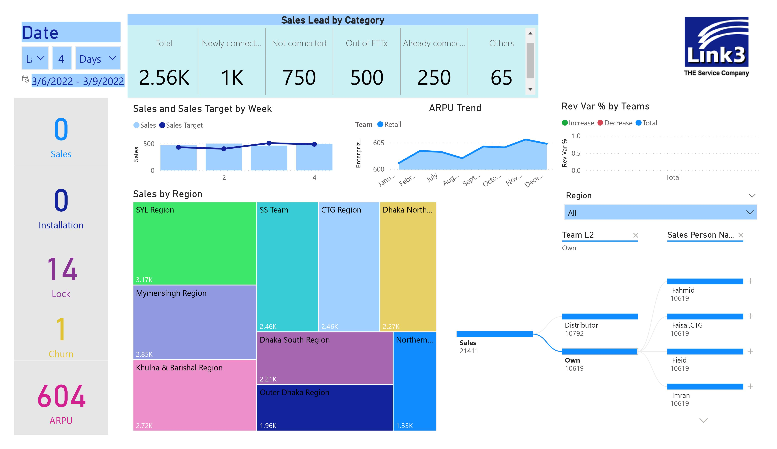

Slide 18
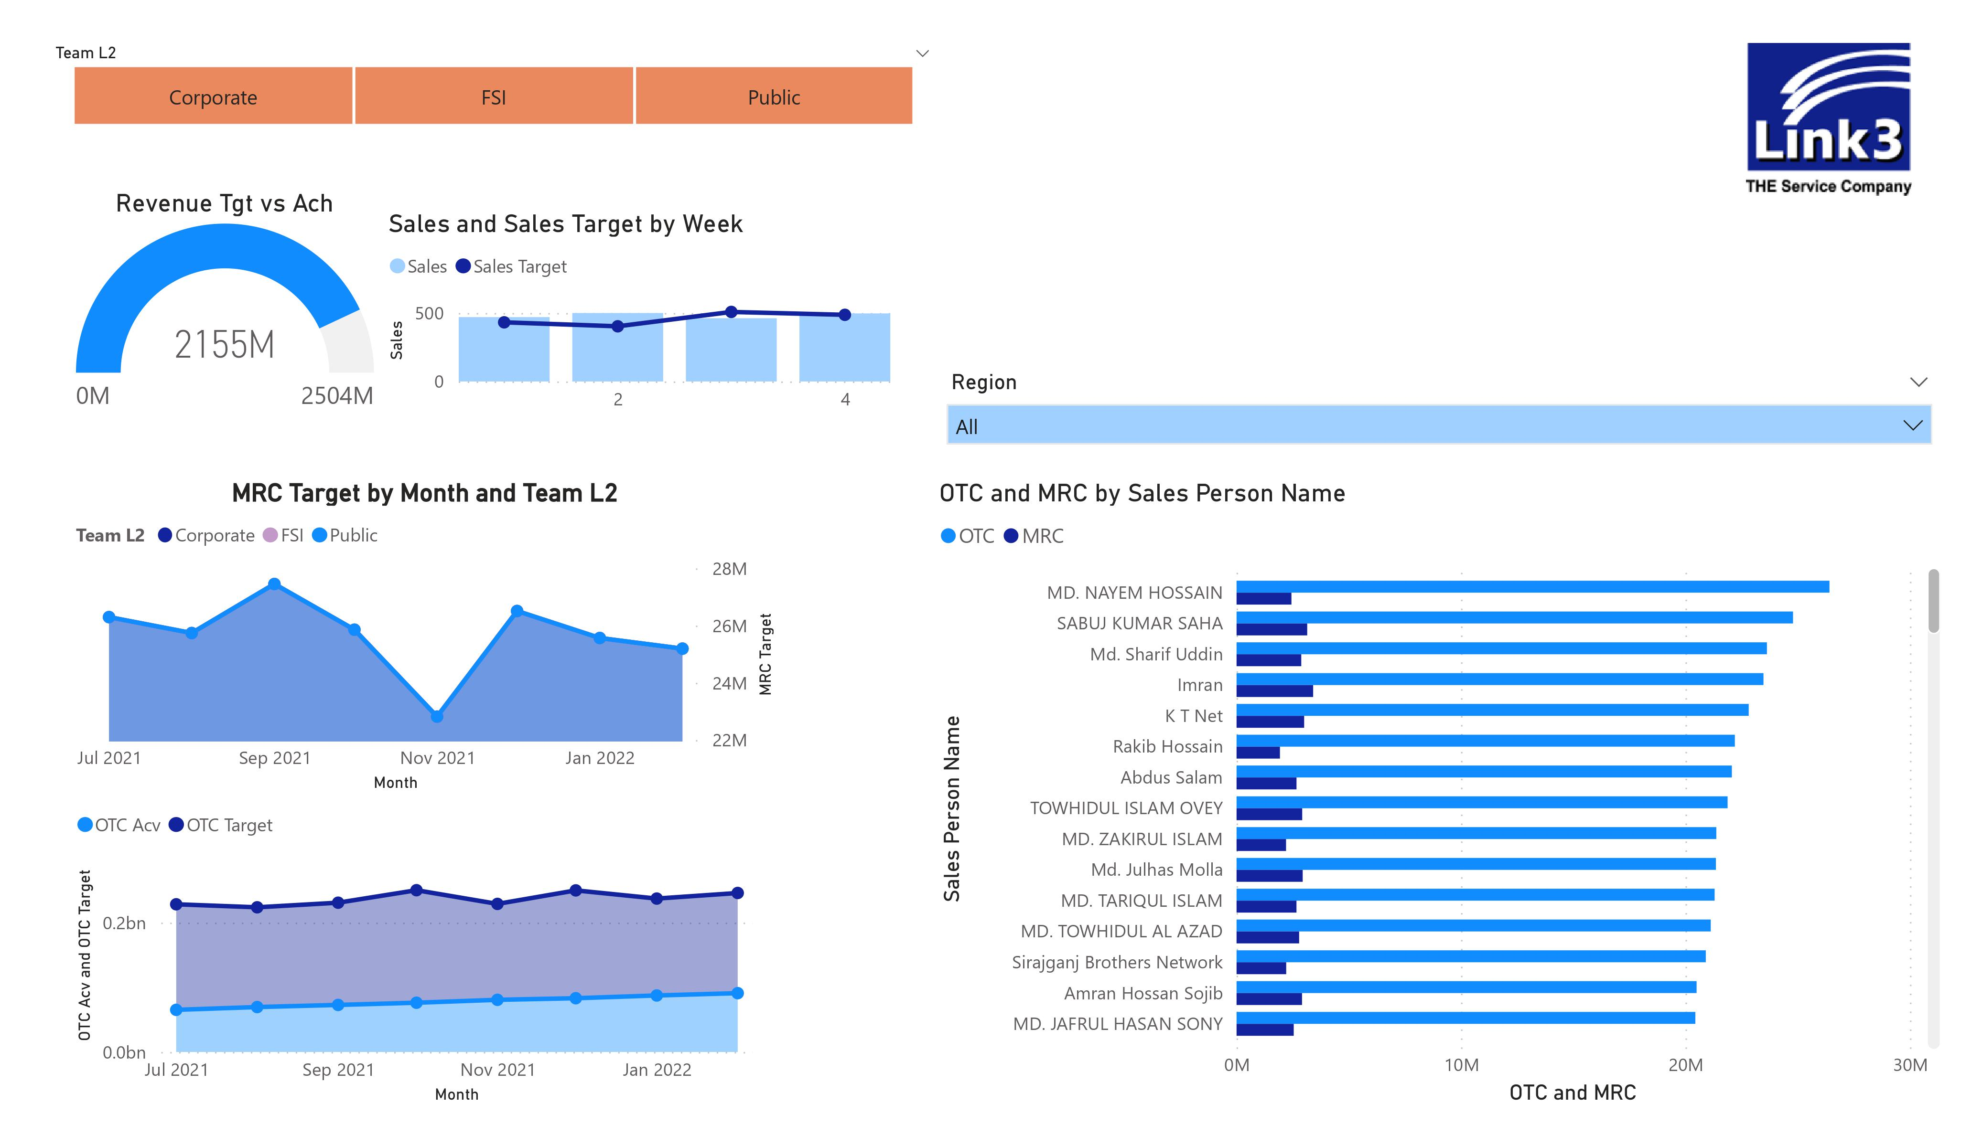

Slide 19
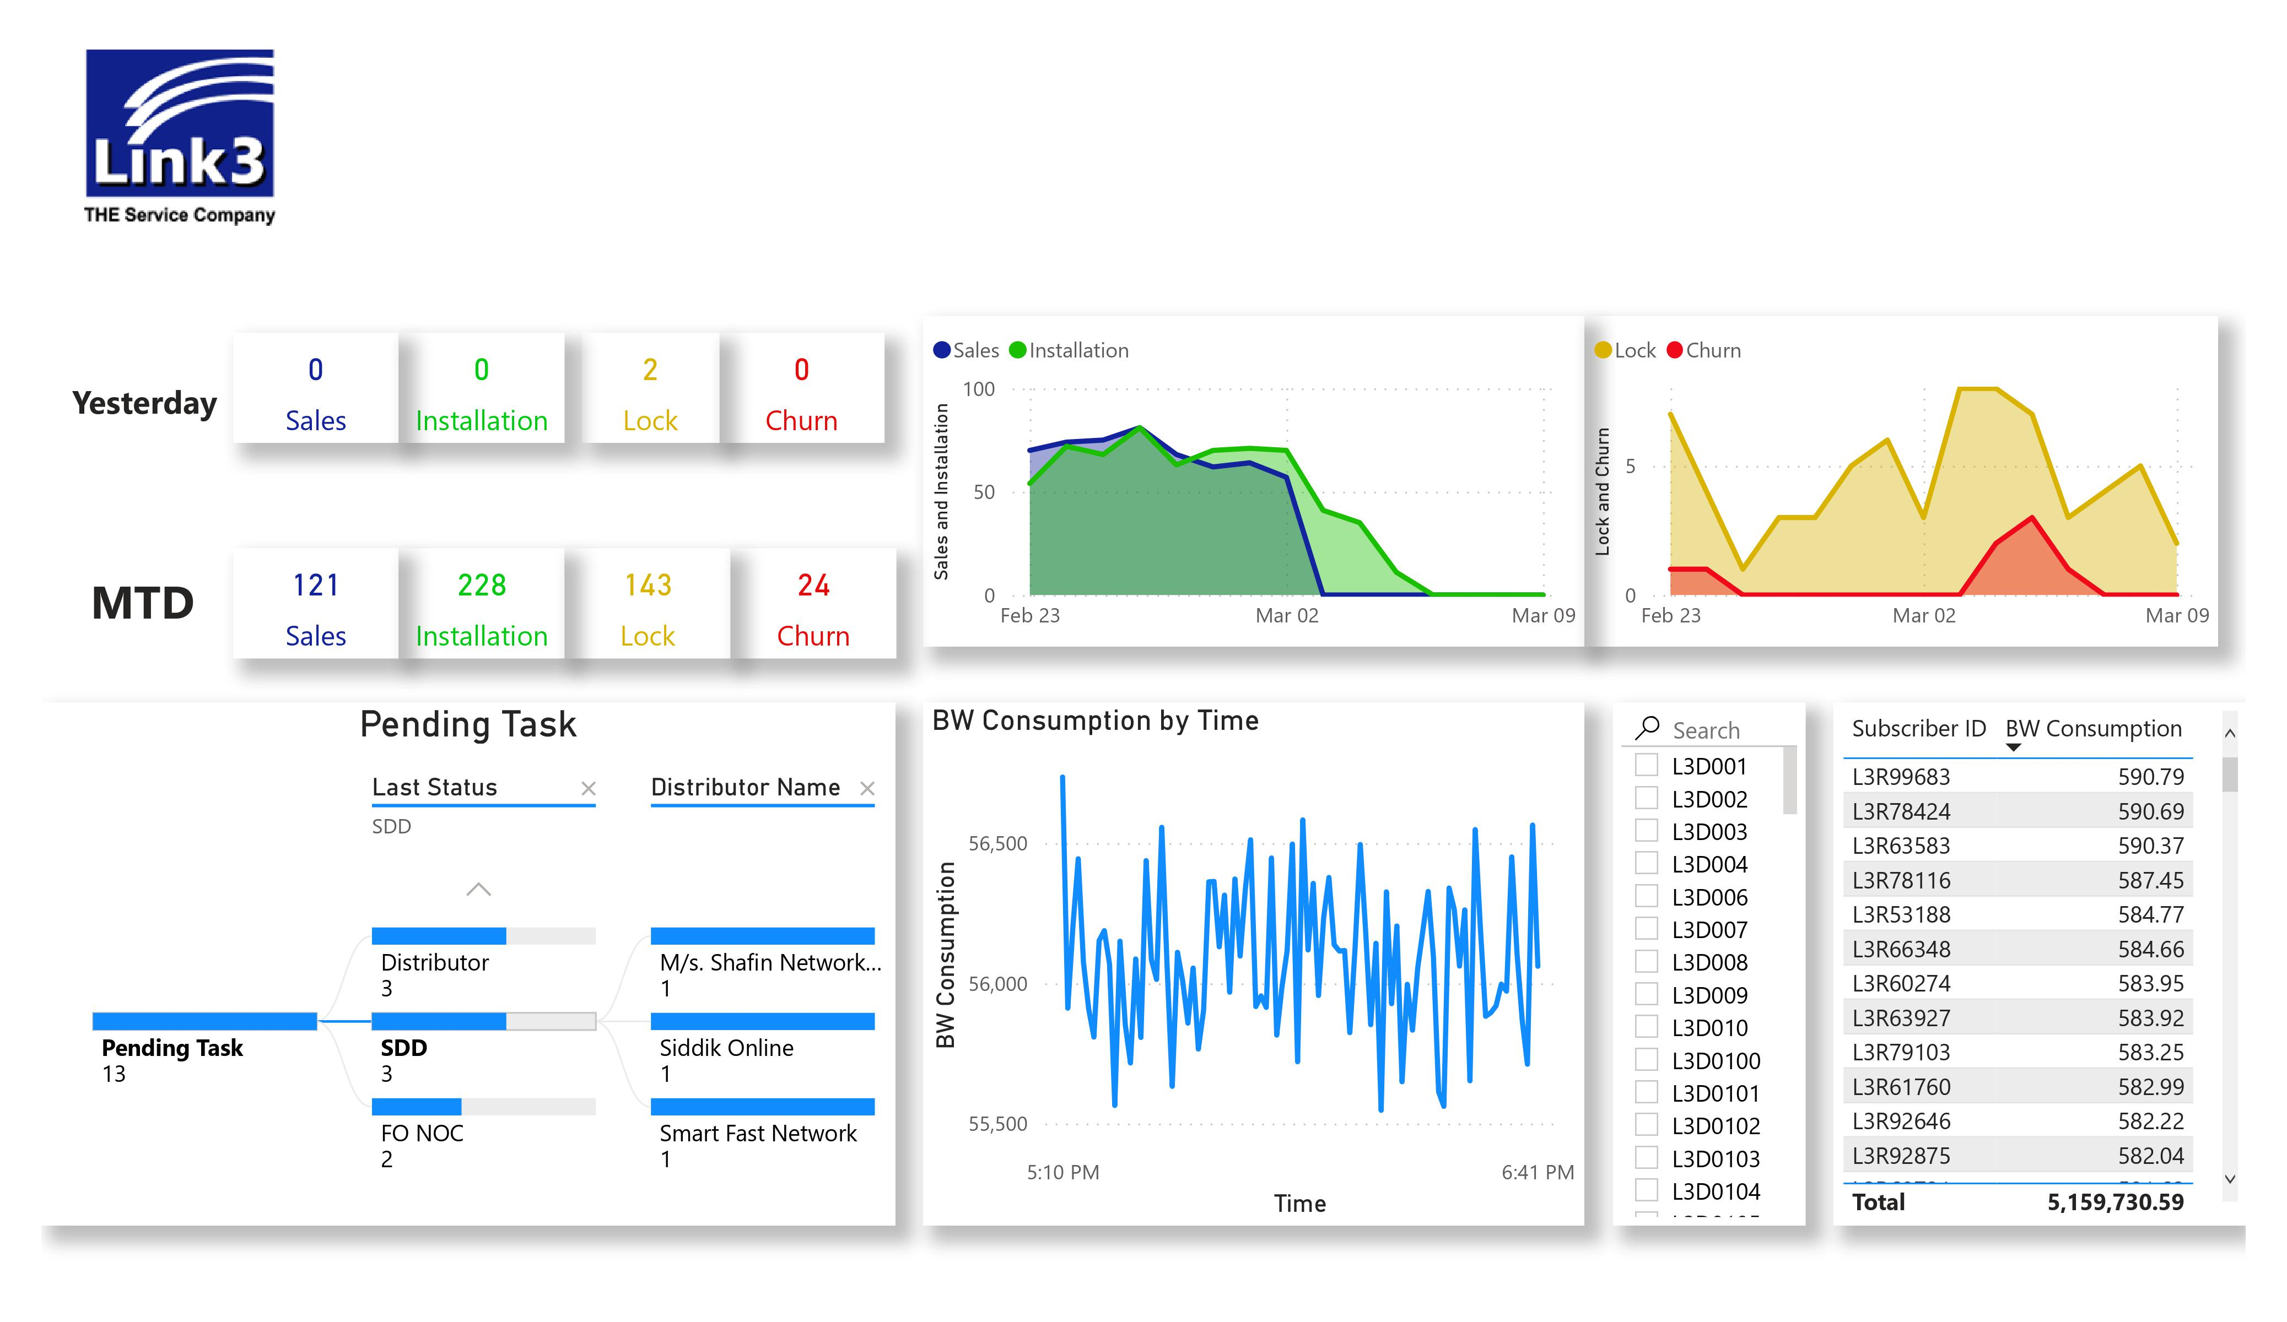

Slide 20
Business Challenges/Soft Issues
Various cross verticals are reluctant to come aboard the Dashboard system as they feel like it would create a loss of control & privacy for their department.
MIS & IT teams sometimes are scared that this might remove their dependencies in the organization and threaten their job.
Everyone wants all the required metrics in the dashboard which creates a cluttered dashboard.
Gets impatient during the data tuning phase

Slide 21

Thank you

